Slide 1
Know Thy Node

Slide 2
Project Week

Slide 3
Instructor’s Feedback
Seriously, mind-blown.

Slide 4
A Little Perspective
Last time I said this you barely knew what a “variable” was.

Slide 5
Specifically…
Things I’ve noticed people doing incredibly well:
Stunning front-end and API integrations
Amazing execution of challenging concepts (no one took the easy road)
Fantastic explanations of your code and technology
And basically everything.
Seriously. Put the GitHub code on your LinkedIn profiles

Slide 6
Next Steps…
Close out your projects well!
Create README’s for your code on GitHub
Use a custom domain URL
Create default, working “test cases”
Consider writing a blog article / video that builds from scratch
Fork / Star other people’s code
And seriously. Put the GitHub code on your LinkedIn profiles

Slide 7
The Mystery of “Backend”

Slide 8

FOCUS!
This next stuff is important!

Slide 9

Full-Stack Development?

Slide 10
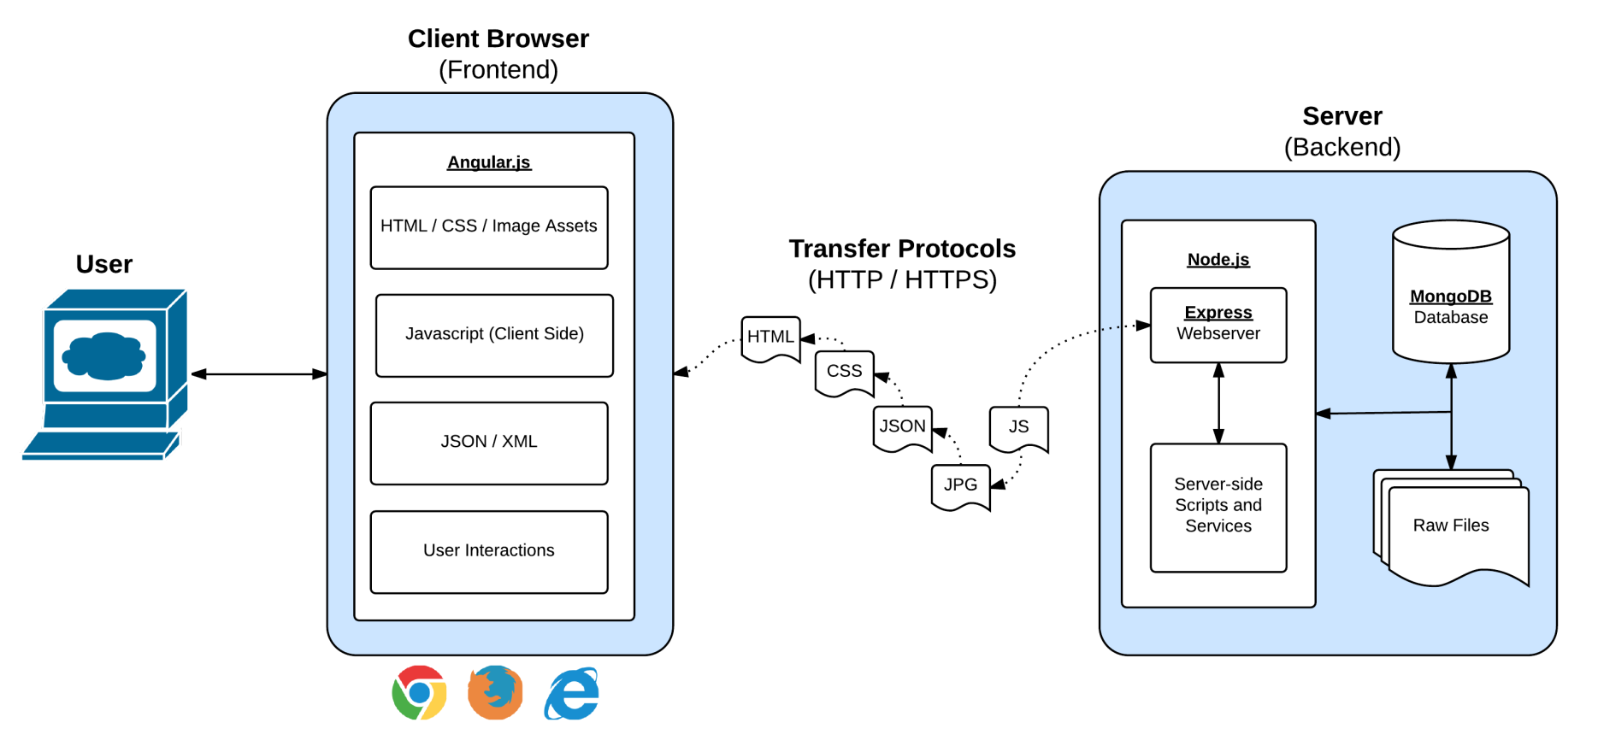
Full-Stack Development
React.js
In modern web applications there is a constant back-and-forth communication between the visuals displayed on the user’s browser (frontend) and the data and logic stored on the server (backend).

Slide 11
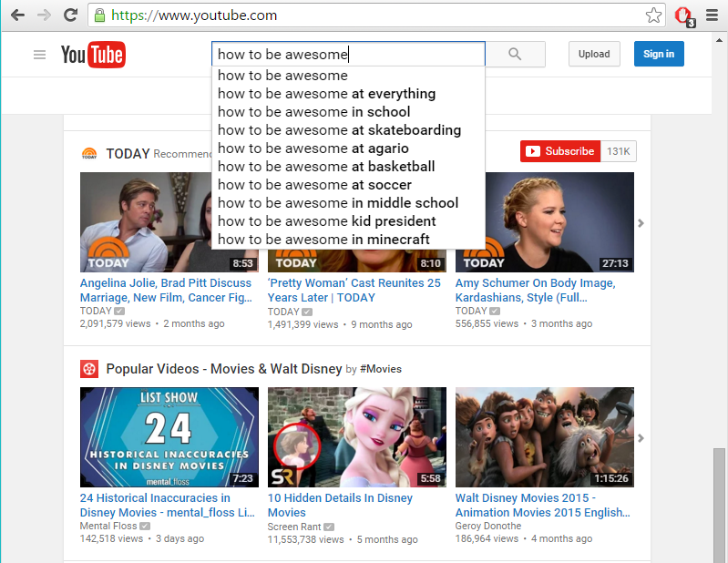
The “Magic” of YouTube

Slide 12
Key Question
Examples of “Server-Side” Code?

Slide 13
Server-Side Code in Action!
API that parse URL parameters to provide selective JSONs
Firebase methods that provide a timestamp back to users
Clicking an invoice that provides a PDF report
Image processing software that takes an image applies a filter, then saves the new version
Google providing “results” relevant to your searches on other sites.

Slide 14
Critical Question
What is a “server”?

Slide 15
Definition of “Server”
A web server takes a client request and gives something back
“A web browser lets a user request a resource. The web server gets the request, finds the resource, and returns something to the user. Sometimes the resource is an HTML page. Sometimes it's a picture. Or a sound file. Or even a PDF document. Doesn't matter--the client asks for the thing (resource) [or action] and the server sends it back.”
“... When we say "server", we mean either the physical (hardware) or the web server application (software) [that actually runs the server commands]”
Kathy Sierra, Author of Head First Servlets and JSP

Slide 16
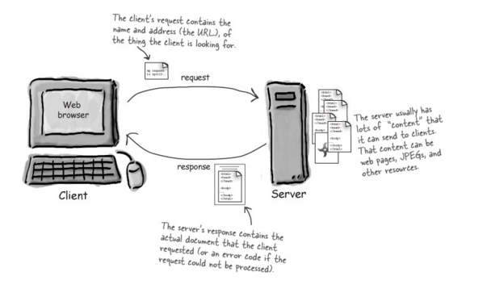
Server Definition

Slide 17
Definition of “Web Client”
Web client lets the user request something on the server and then shows the result (response) of the server.
When we talk about client, though, we usually mean both (or either) the human user and the browser application. The browser is the piece of the software that knows how to communicate with the server. The browser's other big job is interpreting the HTML code [sent by the server] and rendering the web page to the user.
Kathy Sierra, Author of Head First Servlets and JSP

Slide 18
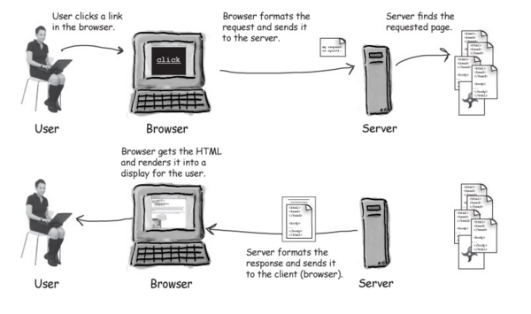
Web Client Definition

Slide 19
> YOUR TURN!!
Assignment
Talk to the person next to you and re-explain to one another the following terms:
Server
Web Client
Request
Response

Slide 20

Aight. Relax.
Yay! You made it through the ultra important stuff!
You can go back to Facebook now
(But…. Not really, the next stuff is still important)

Slide 21
Node.JS

Slide 22
Key Question
So what is NodeJS?

Slide 23
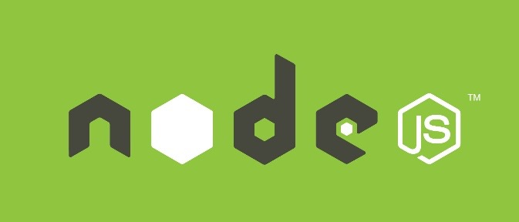
Definition of “NodeJS”
Node.js is an open-source, cross-platform JavaScript runtime environment designed to be run outside of browsers.
It is a general utility that can be used for a variety of purposes including asset compilation, scripting, monitoring, and most notably as the basis for web servers
Our made-up definition of Node. Yay for sounding intelligent!

Slide 24
> YOUR TURN!!
Assignment
Take a few moments to research 5 companies that actively use NodeJS in production.

Slide 25
Why Use NodeJS as a Server?
It re-uses Javascript – meaning a front-end Javascript developer can also build an entire server themselves
It’s easily extendable. Numerous plugins exist to expand the capabilities of Node
Fast-implementation, which allows for the creation of an entire working server with only a few lines of code.
Single-Threaded Asynchronous Model – meaning it can handle multiple requests simultaneously and not get bottlenecked.

Slide 26
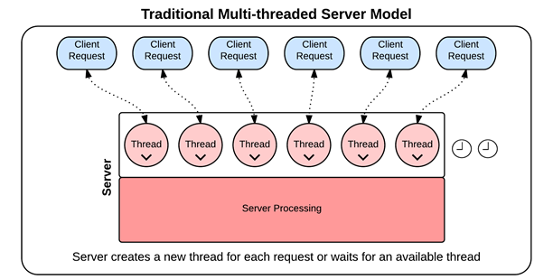
Syncrononous Threading
In traditional synchronous threading, each request requires its own thread. No other request can pass through that thread until complete. Since there is a limited pool of threads, this can create bottlenecks.

Slide 27
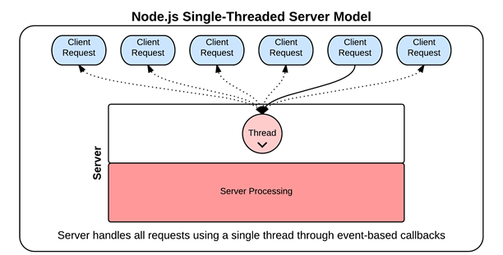
Asynchronous Threading (Node Way)
In Node-based asynchronous threading, a single thread is used throughout. Each thread is “put to the side” using callbacks and responded to when ready. Because of this, there is no limit on the number of requests that can be responded to and there is no bottleneck.

Slide 28
Coding Time!

Slide 29
Homework!

